Slide 1

Smart Garage Parking
Presented by Pioneer team
Under supervision of Engineer: Samer Elsayed

Slide 2
Contents
Motivation
Parts of Garage
Hardware Connections
Software Connections
Usage
Future Enhancement

Slide 3
Motivation
Among the difficulties that confront in everyday life one of most unavoidable test is
parking the car wherever people go. As our need expands our setting out increments
however because of extreme increment in utilization of vehicles and increment in
populace this project confront the intense assignment of parking car especially
amid busiest hours of the day.

Slide 4
Parts of Garage
Arduino Uno board
Servo motor Micro 180 degree
2 IR Sensor
LCD 16x2 I2C
LM35DZ temperature sensor
Small Passive Buzzer ( 5 volt )
2N2222 Transistor + (2k ohm resistor )
4 Leds + 4 ( 330 ohm resistors )

Slide 5
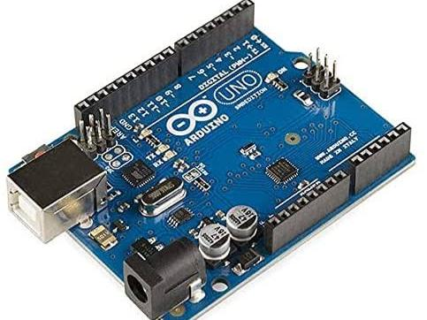
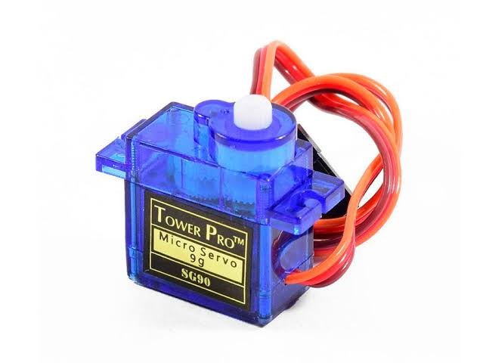
Arduino Uno board
Arduino uno is a microcontroller board based on the ATmega328P. It has 14 digital input/output pins (of which 6 can be used as PWM outputs), 6 analog, a USB connection, a power jack, an ICSP header and a reset button. It contains everything needed to support the microcontroller.
Servo Motor
There are two mainly types (Dc&Ac) we will use (Dc motors),
Types of dc motors are (linear motors, servo motors and stepper motors)
In our project we will use Servo motors:
1) Proper cost
2) Needs low voltage(5V) to reach full power of rotation (this typically for Arduino`s board which we choose)
3) We use it in our project as smart door.

Slide 6
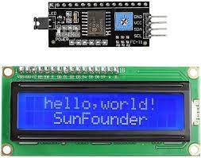
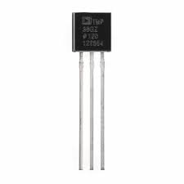
LCD 16x2 I2C
In this project we are using a 16 x 2 LCD display for displaying parking data . The LCD is driven by an I2C adapter module to reduce the number of wires to four; otherwise you need to connect up to 16 wires to Arduino just to drive the display. The I2C module has 16 pins at the output and just four at the input: Vcc, GND, SDA and SCL. The SDA and SCL are I2C bus pins which are connected to A4 and A5 pins of Arduino respectively and it operates on 5V.
LM35DZ : Temperature sensor
can measure temperature in the range of -55°C to 150°C.
It is a 3-terminal device that provides analog voltage proportional to the temperature. Higher the temperature, higher is the output voltage.

Slide 7
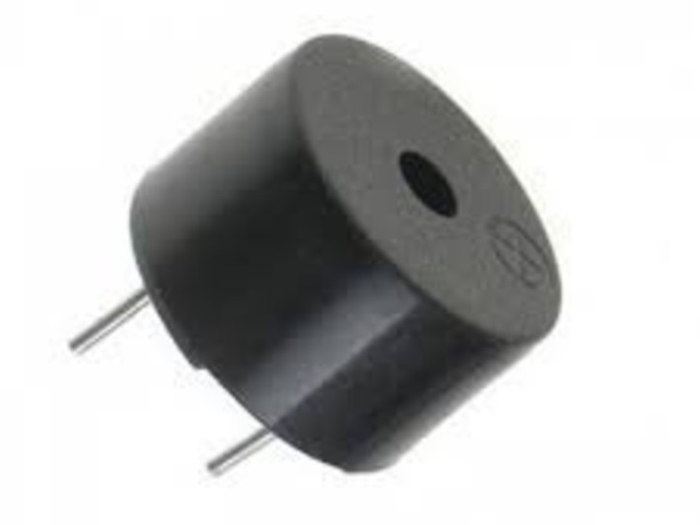
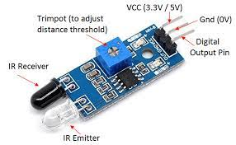

Buzzer: Active buzzer
Has an internal oscillator, so it generates sound as soon as it takes HIGH
It’s the most common type in the market
IR sensor
Active infrared sensors work with radar technology and they both emit and receive infrared radiation. This radiation hits the objects nearby and bounces back to the receiver of the device.
input = LOW in case of detecting an object

Slide 8
HARDWARE CONNECTIONS

Slide 10
SOFTWARE CONNECTIONS

Slide 11
Arduino car software code:
#define m1step 2
#define m1dir 3
#define m2step 4
#define m2dir 5
char t;
void setup() {
pinMode(m1step, OUTPUT); //left motors forward
pinMode(m1dir, OUTPUT); //left motors reverse
pinMode(m2step, OUTPUT); //right motors forward
pinMode(m2dir, OUTPUT); //right motors reverse
pinMode(9, OUTPUT); //Led
Serial.begin(9600);
}
void loop() {
if (Serial.available()) {
t = Serial.read();
Serial.println(t);
}
if (t == 'F') { //move forward(all motors rotate in forward direction)
digitalWrite(m1step, HIGH);
digitalWrite(m2step, HIGH);
}
else if (t == 'B') { //move reverse (all motors rotate in reverse direction)
digitalWrite(m1dir, HIGH);
digitalWrite(m2dir, HIGH);
}
else if (t == 'R') { //turn right (left side motors rotate in forward direction, right side motors doesn't rotate)
digitalWrite(m2step, HIGH);
digitalWrite(m1dir, HIGH);
}
else if (t == 'L') { //turn left (right side motors rotate in forward direction, left side motors doesn't rotate)
digitalWrite(m1step, HIGH);
digitalWrite(m2dir, HIGH);
}
else if (t == 'S') { //STOP (all motors stop)
digitalWrite(m1step, LOW);
digitalWrite(m1dir, LOW);
digitalWrite(m2step, LOW);
digitalWrite(m2dir, LOW);
}
//delay(120);
}

Slide 12
Why SMART GARAGE PARKING ?

Slide 13

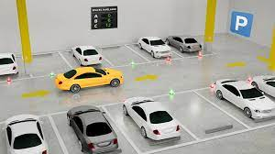
Advantages of Smart Garage Parking
Our project detects the empty slots and helps the drivers to find parking space in unfamiliar city. The average waiting time of users for parking their vehicles is effectively reduced in this system. The optimal solution is provided by the proposed system, where most of the vehicles find a free parking space successfully. Our preliminary test results show that the performance of the Arduino UNO based system can effectively satisfy the needs and requirements of existing car parking .
This smart parking system provides better performance, low cost and efficient large scale parking system.

Slide 14
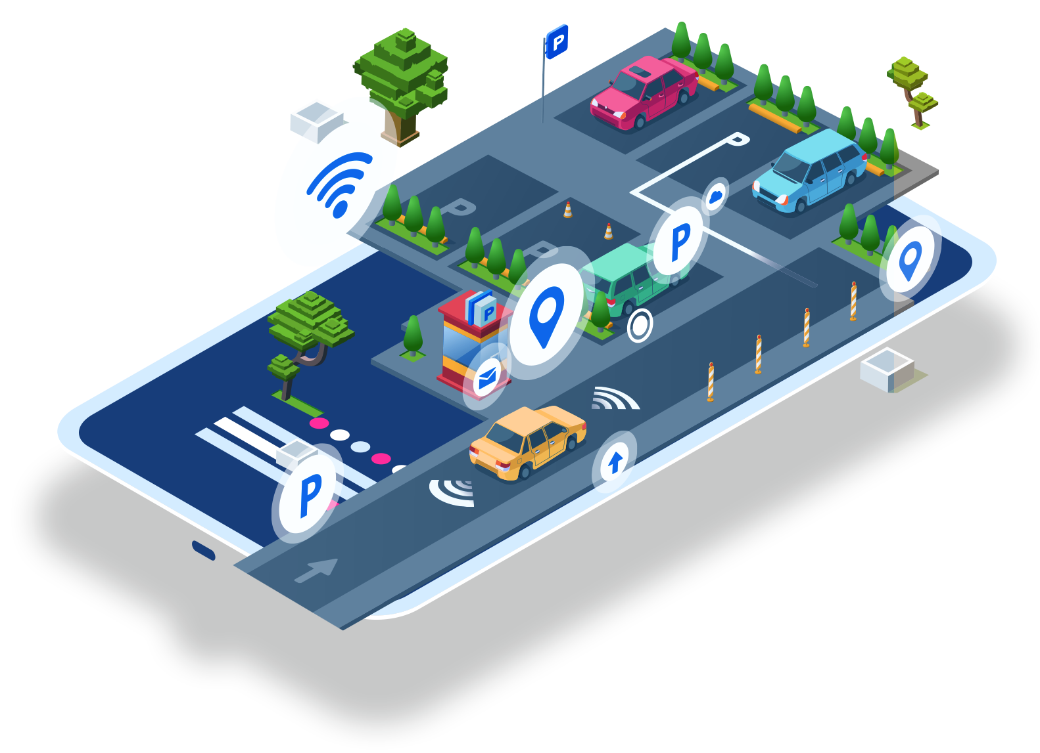
FUTURE ENHANCEMENT
In future works, this framework can be enhanced by including different applications, For Example,
internet booking by utilizing GSM. The driver or client can book their parking area at home or while in
transit to the shopping center. This can diminish the season of the client to seeking the empty parking
area. As a further review, distinctive sensor frameworks can be added to enhance this framework to
distinguish the question and guide the driver or clients speediest.

Slide 15


